Slide 1


AVO depth trends for lithology and pore fluid classification
Koncz Melinda
Dept. of Geophysics & Space Sciences, Eötvös University, Budapest
Consultants:
Kocsis Gábor
Drahos Dezső
Békéscsaba
ISZA 2013.04.05.

Slide 2
1. Introduction and aims
Quantitative seismic interpretation is becoming more and more important in exploration and characterization of petroleum reservoirs.
Nature creates inhomogeneous anisotropic rocks where the rock physics properties vary at different positions and directions. It is important to analyze and quantify the property changes as a function of depth.
Combining rock physics depth trends with AVO technique, we can obtain a more exact interpretation.
The depth-dependent AVO technique enables us to predict the most likely lithology and pore fluid from seismic data, even in areas with sparse local well-log information.

Slide 3
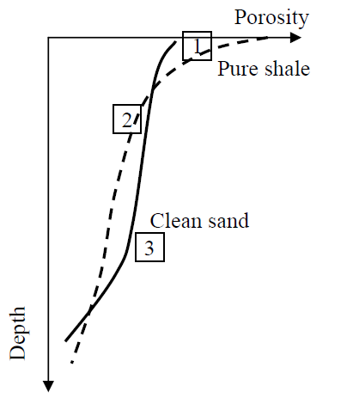
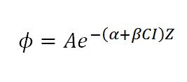
2. Compaction of sands and shales
Porosity depth trends (Ramm & Bjørlykke)
Deposition
Mechanical compaction
Cementation
A – Critical porosity
α, β – Regression coefficient
CI – Clay Index
Z – Depth

Slide 4
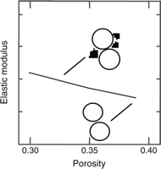
3. Rock physics properties as a function of compaction
The friable-sand model (Dvorkin & Nur)
2 theoretical models for high-porosity sands:
Well-sorted end member: well-sorted packing of similar grains whose elastic properties are determined by the elasticity at the grain contact
Friable-sand model: the well-sorted end member modified with additional smaller grains deposited in the pore space
These additional grains deteriorate sorting, decrease the porosity, and only slightly increase the stiffness of the rock.

Slide 5
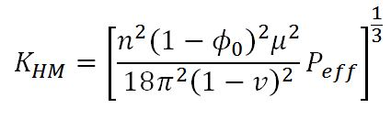
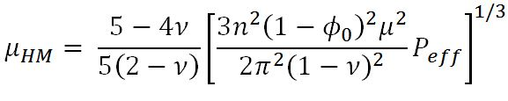
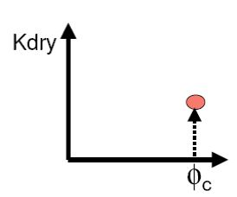
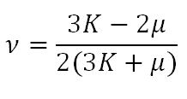
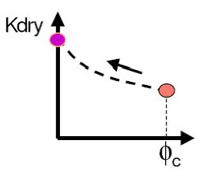

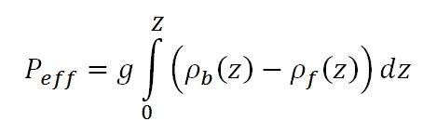
3. Rock physics properties as a function of compaction
Hertz-Mindlin theory

Slide 6
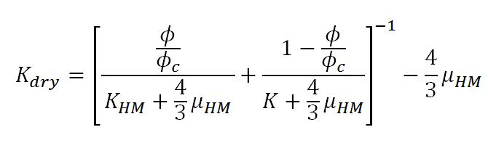
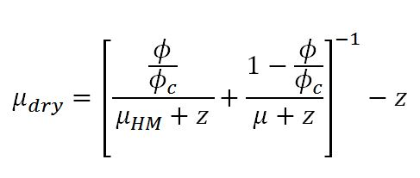
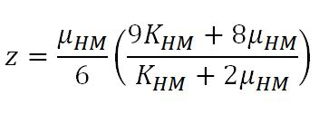
3. Rock physics properties as a function of compaction
Hashin-Shtrikman bounds
Lower H-S bound
The upper bound is usually used for cemented, and the lower bound for unconsolidated sands. For the modeling purposes in this work a modified Hashin-Shtrikman lower bound has been used. It connects two end members (high porosity and zero porosity) in the porosity-moduli plane.

Slide 7
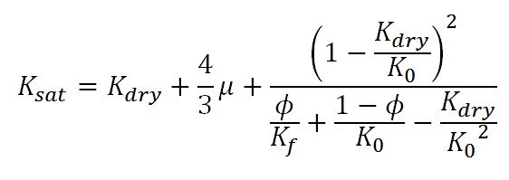

3. Rock physics properties as a function of compaction
Gassmann’s fluid substitution
Fill the pore space with different fluids

Slide 8
4. Workflow
n, P_{eff}, ϕ_{c},φ, K₀, μ₀, ν₀
K_{HM} = f(n, ϕ_{c}, ν₀, P_{eff})
μ_{HM} = f(n, ϕ_{c}, μ₀, ν₀, P_{eff})
K_{dry} = f(n, ϕ_{c}, ϕ, K_{HM}, μ_{HM}, K₀)
μ_{dry} = f(n, ϕ_{c}, ϕ, K_{HM}, μ_{HM}, K₀)
K_{fl} = f(K_{w}, K_{HC}, S_{w})
K_{sat} = f(K_{dry}, K₀, K_{fl}, ϕ)
μ_{sat} = μ_{dry}
ρfl = f(ρ_{w}, ρ_{HC}, S_{w})
ρ_{b} = f(ϕ, ρ_{ma}, ρ_{fl})
V_{p} = f(K_{sat}, μ_{sat}, ρ_{b})
V_{s} = f(μ_{sat}, ρ_{b})
Monte-Carlo Simulation
AVO

Slide 9
5. Dataset
Pre-stack seismic sections
Well logs (DT, DTS, Density, Porosity, Vsh, Sw)
„Unknown”
Test Well
WELL-1

Slide 10
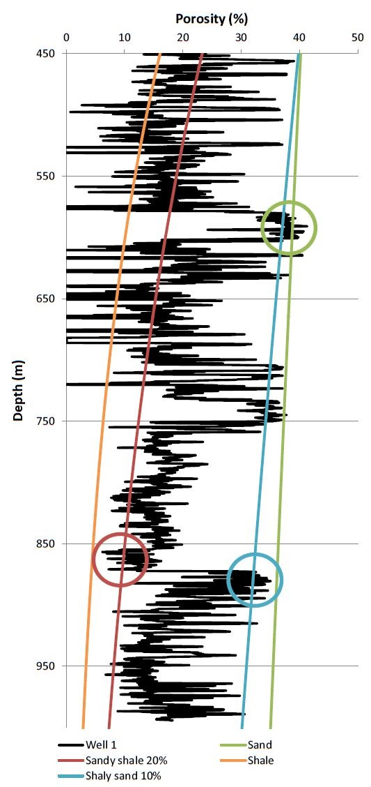
6. Results – Porosity depth trends
Porosity trends need to be calibrated to the local conditions
Apply to the „Test Well”

Slide 11
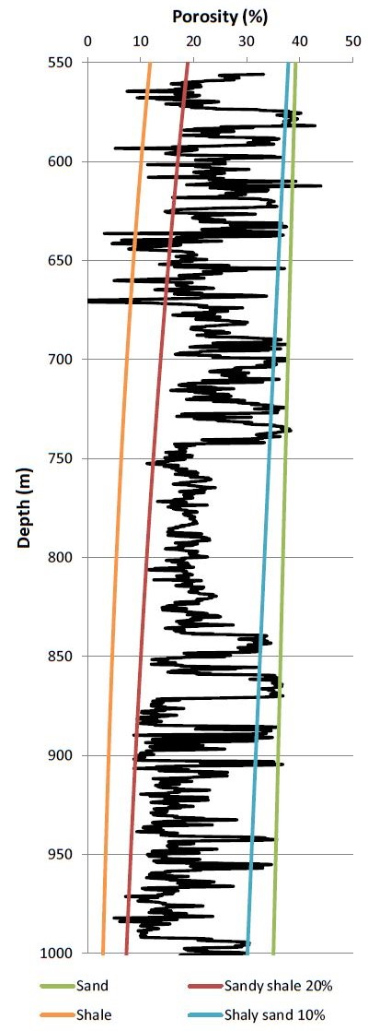
6. Results – Porosity depth trends
„Unknown” well

Slide 12
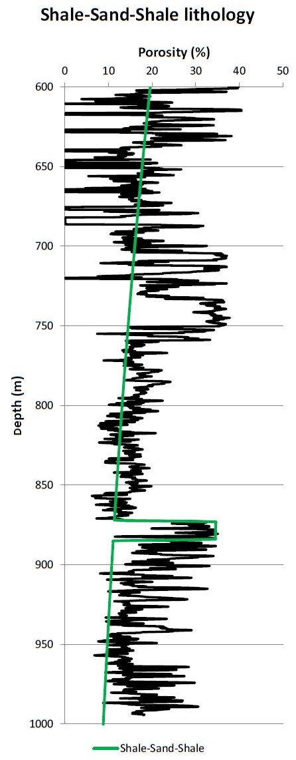
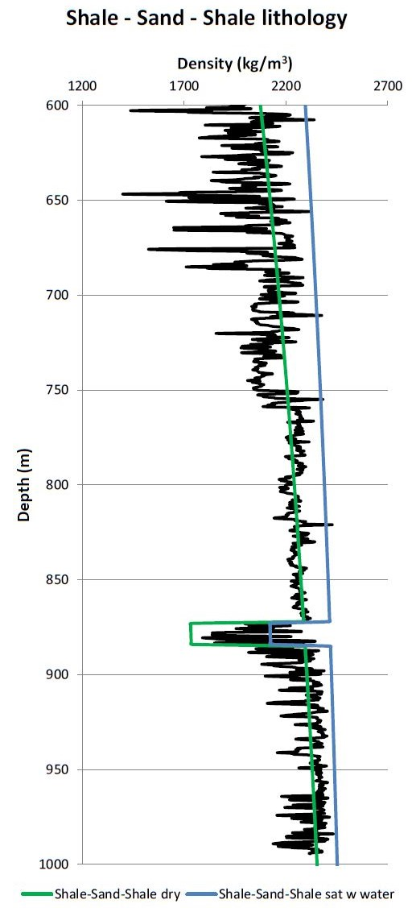
6. Results – Lithology models
Shale - Sand - Shale
Sandy Shale - Sand - Sandy Shale
Shale - Shaly Sand - Shale
Sandy Shale - Shaly Sand - Sandy Shale

Slide 13
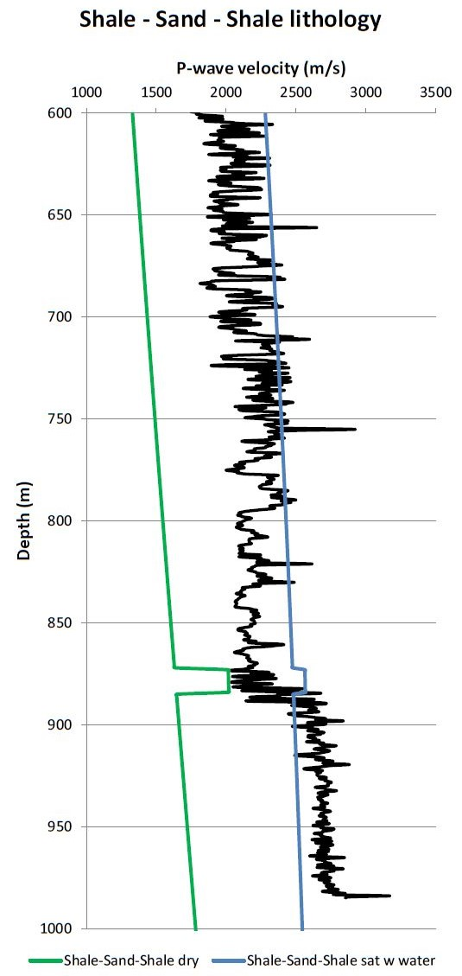
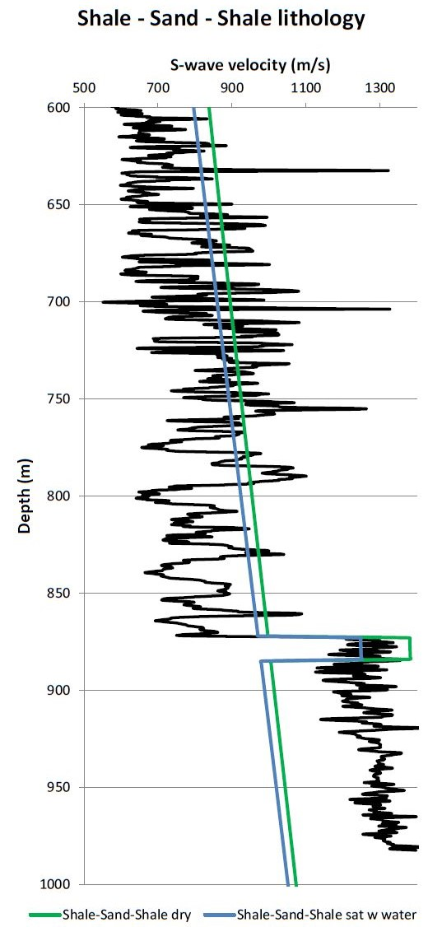
6. Results – Lithology models
Shale - Sand - Shale
Sandy Shale - Sand - Sandy Shale
Shale - Shaly Sand - Shale
Sandy Shale - Shaly Sand - Sandy Shale

Slide 14
6. Results – Fluid Replacement Modeling
Hampson-Russell software
We can define:
Volume fraction of the constituents - different lithologies
Fluid parameters (type, temperature, salinity, saturation) - different fluid saturation
Average Vp, Vs, Density values (above and below the reservoir + in the reservoir)

Slide 15
6. Results – Monte-Carlo simulation
Calculate normal distribution all of the average Vp, Vs and Density values
Run Monte-Carlo Simulation (500 random value)
500 possible variation of the Vp - Vs - Density combination
Values

Slide 16
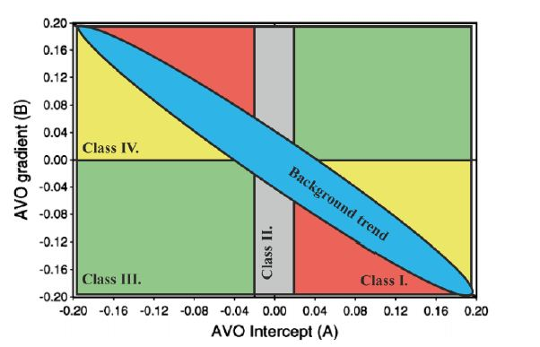
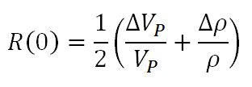
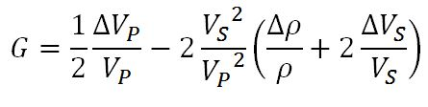
6. Results – Statistical AVO modeling
Shuey approximation
Intercept
Gradient
For each type of interface category, the expected AVO response at a target depth is calculated using Shuey’s approximation to the Zoeppritz equation.

Slide 17
6. Results – Statistical AVO modeling
Shale - Sand - Shale lithology
Upper bound
Lower bound
WATER
GAS

Slide 18
6. Results – Statistical AVO modeling
Sandy Shale - Sand - Sandy Shale lithology
Upper bound
Lower bound

Slide 19
6. Results – Statistical AVO modeling
Shale - Shaly Sand - Shale lithology
Upper bound
Lower bound

Slide 20
6. Results – Statistical AVO modeling
Sandy Shale - Shaly Sand - Sandy Shale lithology
Upper bound
Lower bound

Slide 21
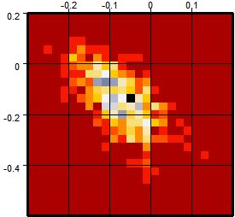
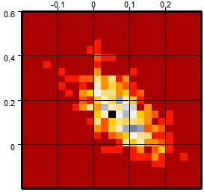
6. Results - Probability Density Functions
Shale - Sand - Shale Upper bound
Shale - Sand - Shale Lower bound
100 % water saturation

Slide 22
7. Summary and future plans
Advantages
We can determine the most likely lithology and pore fluid
Reduce the drilling’s uncertainty
Pitfalls
H-M Theory overpredicts the velocities in unconsolidated sands
We can’t separate the different gas contents
Future plans
Calibrate Intercept and Gradient estimated from pre-stack seismic sections to the modeled AVO pdfs

Slide 23
Acknowledgement
Kocsis Gábor
Drahos Dezső
Thank you for your kind attention!

