Slide 1



Reinterpretation of granites from the Ditrău Alkaline Massif
Ódri Ágnes
Department of Mineralogy, Geochemistry and Petrology, University of Szeged
Vulcano Research Group
Meetinf of Young Geoscientists, Békéscsaba 05-06. 04. 2013

Slide 2
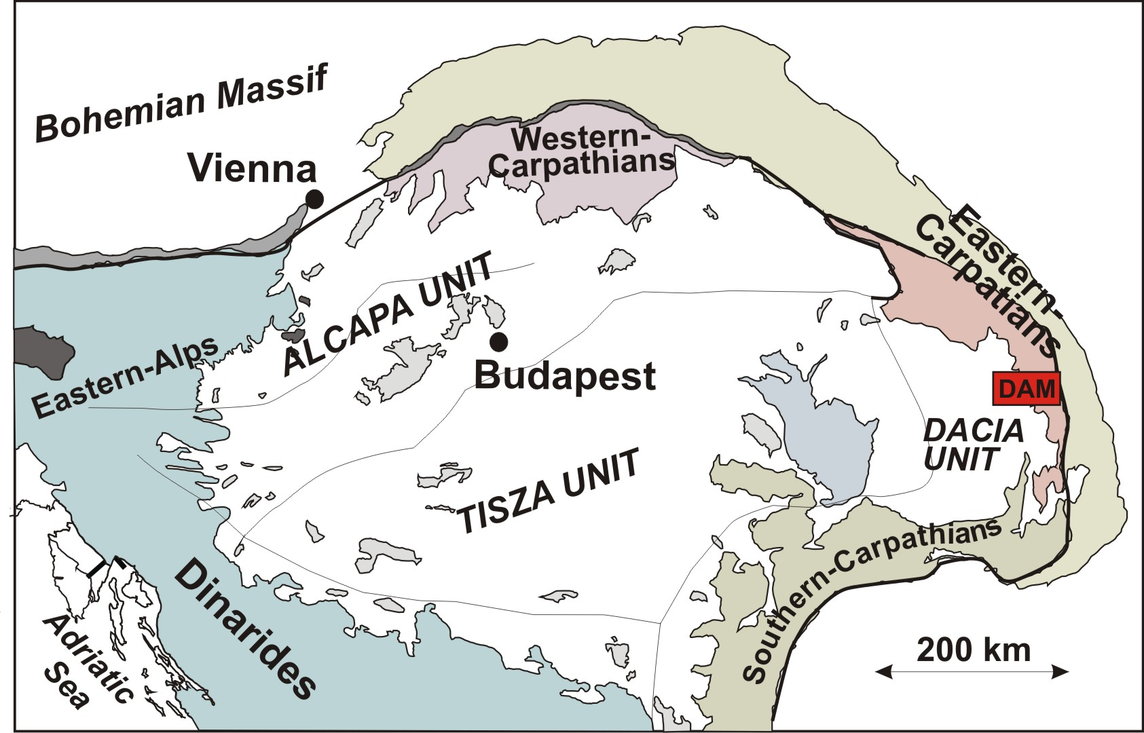
Geological Setting

Slide 3
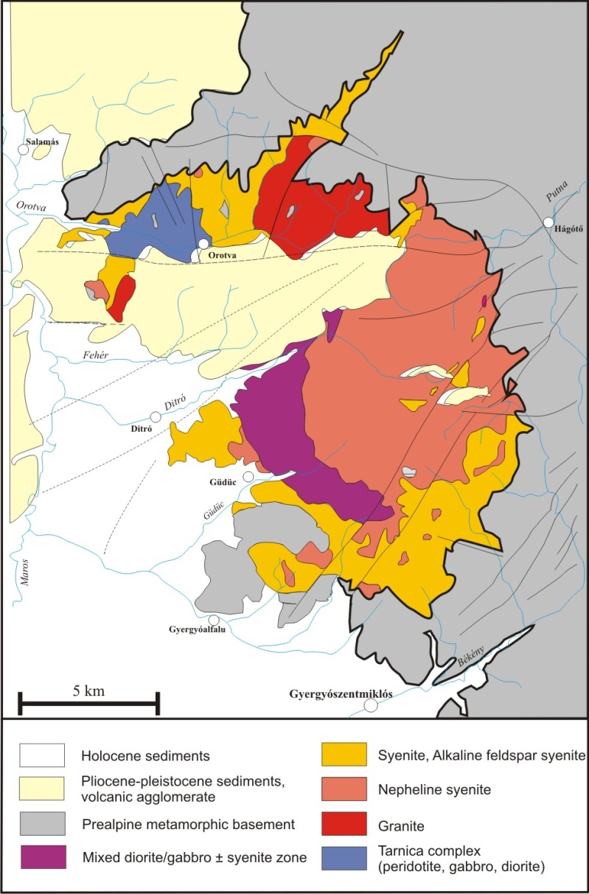
Background of the research
Previous studies about granitoids (Streckeisen, 1954; Jakab, 1998; Morogan et al., 2000; Kovács and Pál-Molnár, 2005).
There is no detailed investigation about granites.
NE part of the Orotva-creek homogeneous granite body → various intermediate and acidic (Kovács, 1997).
A-type, intraplate granitoids (Pál-Molnár and Kovács, 2005).

Slide 4
The objective of the research
The evolution of basic magma resulted an foid-syenite and granite end systems (Eby, 1987).
The petrographic, geochemical, petrogenetical investigations, as well as the identification of relationships between granites and other rock types within the massif.

Slide 5
Characteristics of A-type granites
A-type: - Loisille and Wones, 1979
- Continental rift-zones; Mid-oceanic ridge
Genesis: 1. Crust-source, low degrees of partial melting of granulite as a result of uplifting.
    2. Fractionation of mantle-derived basaltic magmas; Continental rift-zones.
      3. Mantle-derived tholeiitic granites (Frost and Frost, 1997); Mid-oceanic ridge.
Distinct geochemical features (high FeO, REE, HFSE; low CaO, Ba, Sr, Eu) (Whalen, 1987).
Crust- and mantle-derived A-type granites have similar mineralogy and geochemistry (Sylvester, 1989).

Slide 6
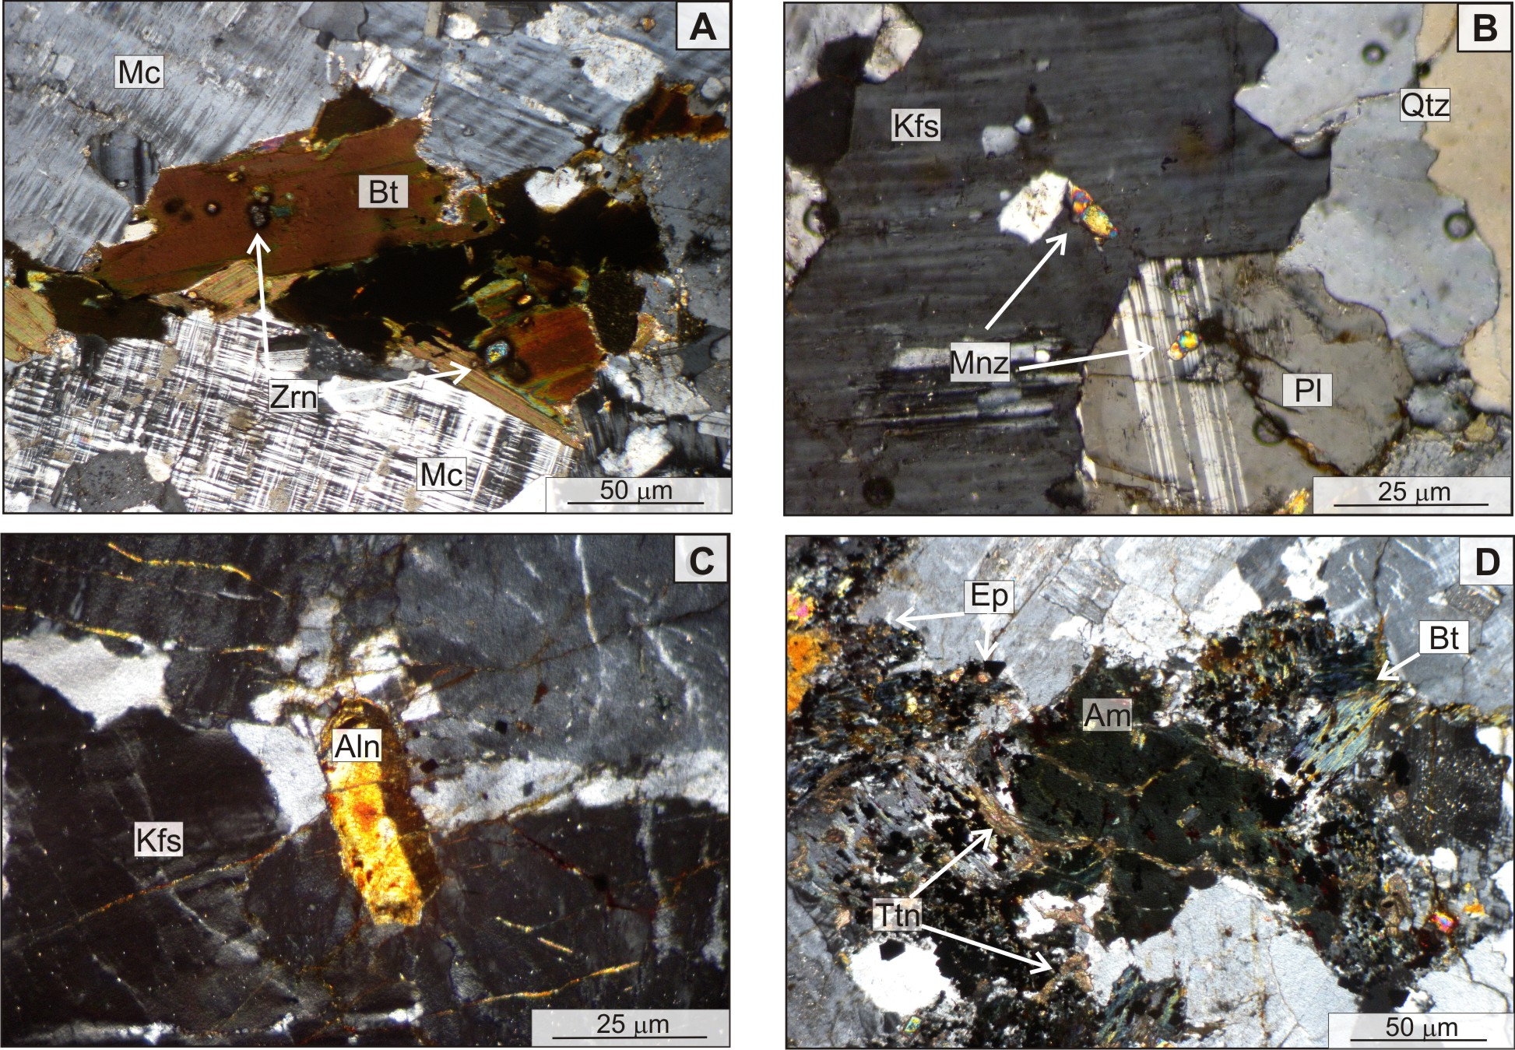
Petrography

Slide 7
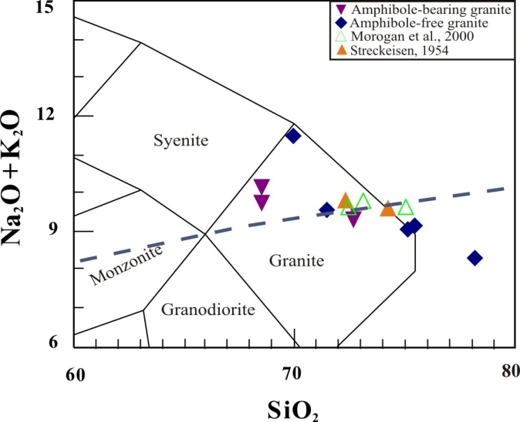
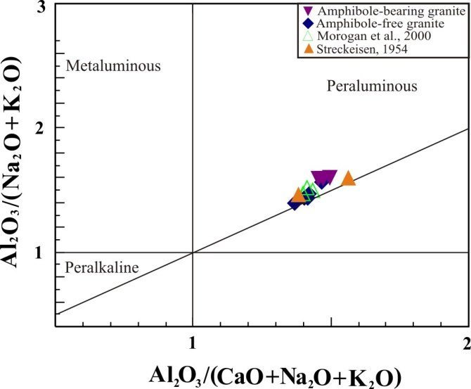
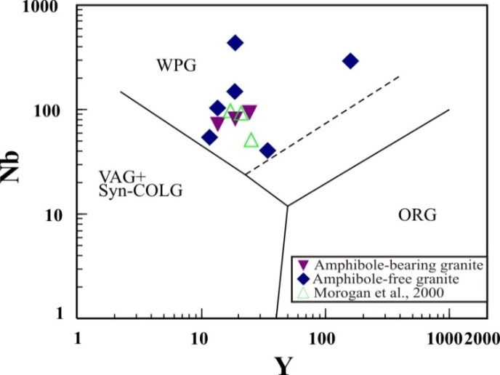
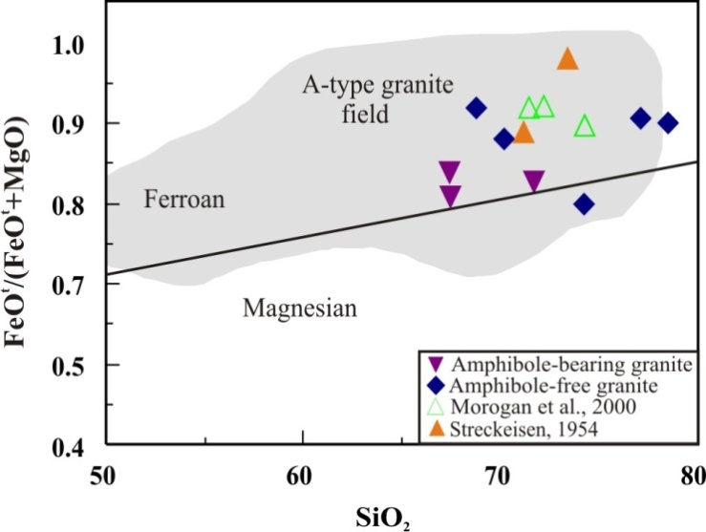
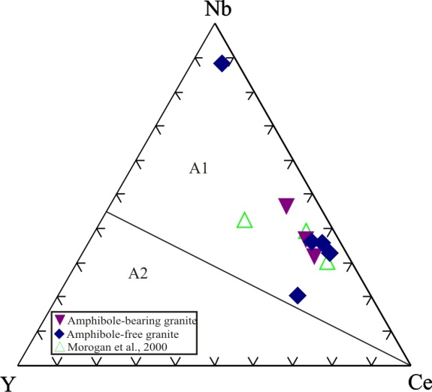
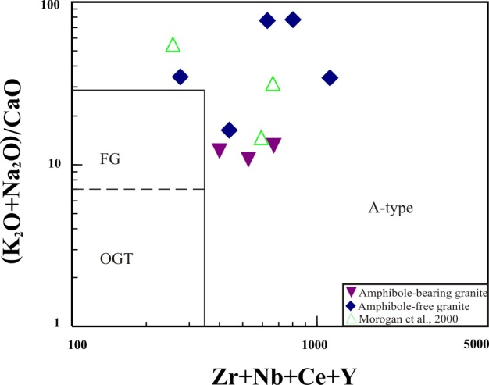
Results I.

Slide 8
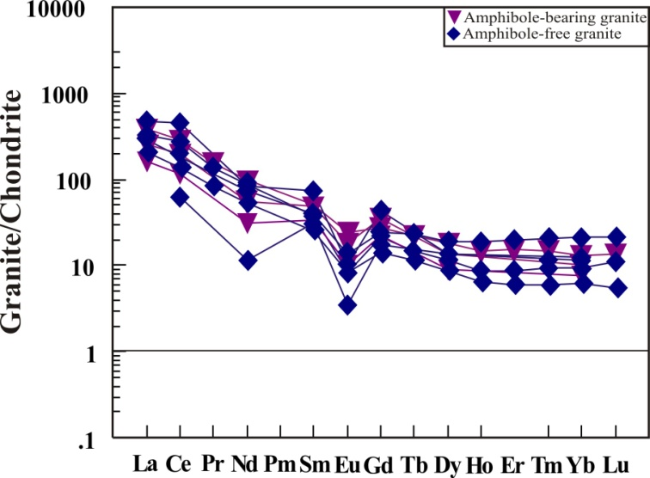
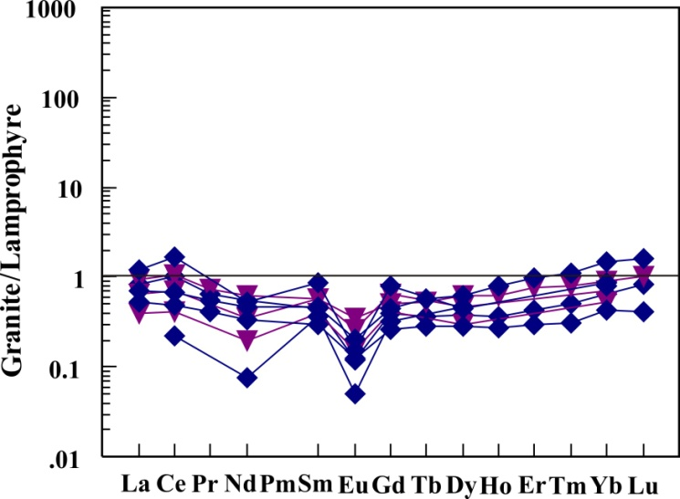
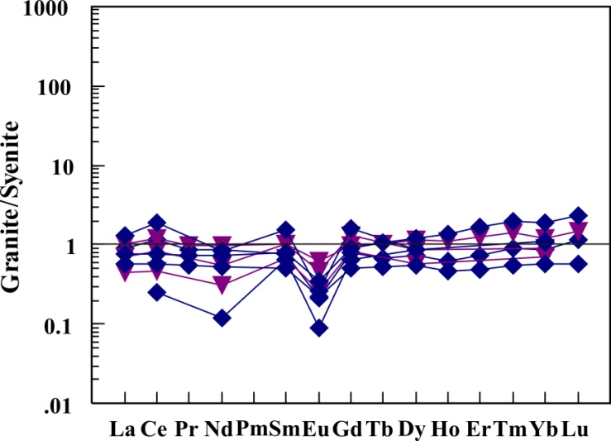
Results II.

Slide 9
Conclusion I.
The principal geochemical characteristics of the studied granites are coincident with the geochemical signatures of A-type granites (Whalen, 1987).
Amphibole-bearing granites are less francionated, which also evidenced by the mg# of the studied rocks (100[MgO/(MgO+FeO^{t})]=17-21.3 and 7.8-13
Fe-content → fractionation of mantle derived magmas likely crystallized under reduced conditions in an extensional environment (Frost et al., 2001).
Peraluminious granites including monazite which typical in crust-derived granites (Shand, 1943)
Extreme amphibole fractionation, volatile interaction or pelitic rock assimilation (Clarke, 1992) → (Th/La)_{N} = 0.32 to 0.58 evidence of crustal contamination for the DAM granites.

Slide 10
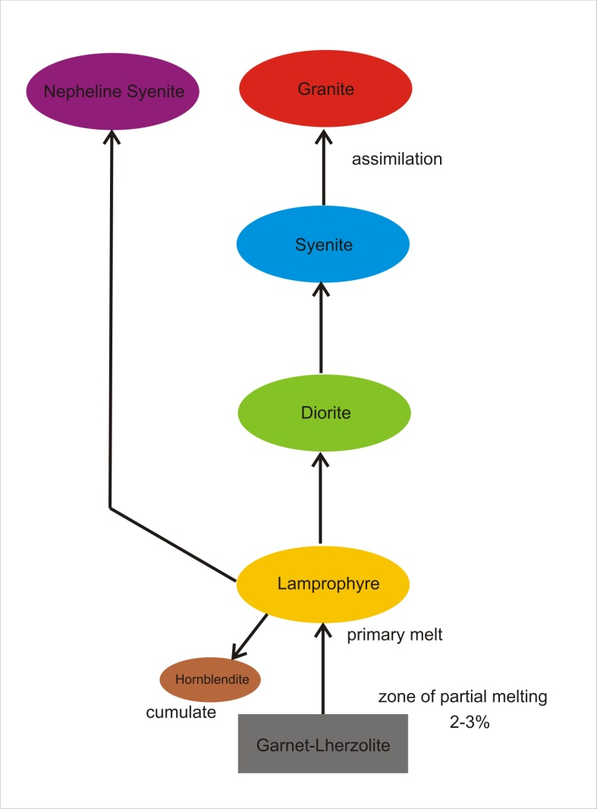
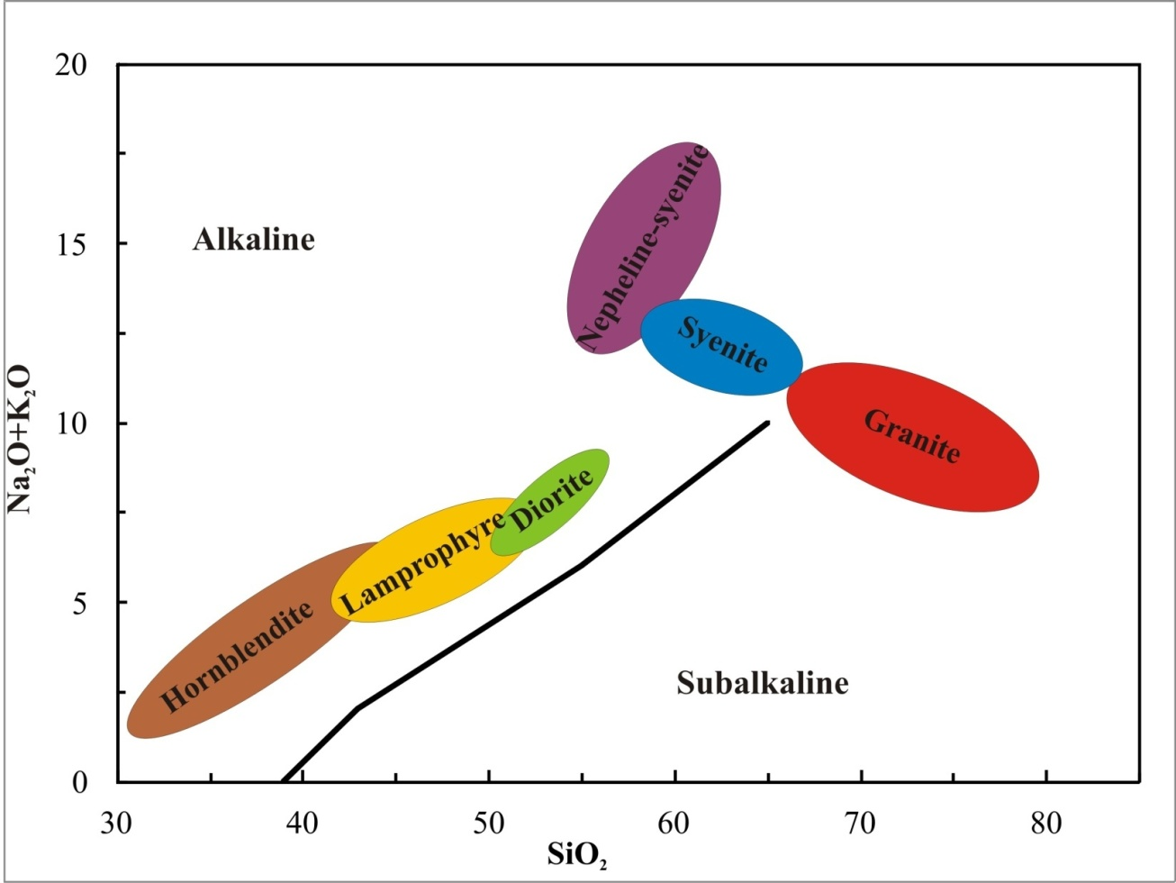
Conclusion II.
AFC
FC

Slide 11
References
Clarke, D.B. (1992): Granitoids Rocks, Topics in the Earth Sciences. Chapman and Hall, Vol. 7, London, 283.
Eby, G. N. (1987): The Monteregian Hills and White Mountain alkaline igneous provinces, eastern North America. In: Fitton JG, Upton BGJ (eds) Alkaline Igneous Rocks. Geol Soc Spec Publ 30: 433-477
Frost, C.D., Frost, B.R. (1997): High-K, iron-enriched rapakivi-type granites: the tholeiite connection. Geology 25, 647–650.
Frost, B.R., Barnes, C.G., Collins, W.J., Arculus, R.J., Ellis, D.J., Frost, C.D. (2001): A geochemical classification for granitic rocks. Journal of Petrology 42, 2033–2048.
Jakab, Gy. (1998): Geologia Masivului alcalin de la Ditrău. Pallas-Akad., M.-Ciuc., 298.
Kovács, G., Pál-Molnár, E. (2005): A Ditrói alkáli masszívum granitoid kőzeteinek petrogenezise. Földtani Közlöny 135/1, 121-143
Loiselle, M.C., Wones, D.R. (1979): Characteristics and origin of anorogenic granites. Abstracts of papers to be presented at the Annual Meetings of the Geological Society of America and Associated Societies, San Diego, CA 11, 468.
Morogan, V., Upton, B.G.J., Fitton J.G. (2000): The petrology of the Ditrău alkaline complex, Eastern Carpathians. Mineralogy and Petrology, 69, 227-265.
Pál-Molnár, E. (2000): Hornblendites and diorites of the Ditrau Syenite Massif. Ed. Department of Mineralogy, Geochemistry and Petrology, University of Szeged, Szeged, 172.
Streckeisen, A. (1954): Das Nephelinsyenit-Massiv von Ditro (Siebenbürgen), II. Teil. Schweiz. Min.Petr. Mitt., 34, 336-409.
Sylvester, P.J. (1989): Post-collisional alkaline granites. Journal of Geology 97, 261–280.

Slide 12
Thank you for your attention!
The presentation is supported by the European Union and co-funded by the European Social Fund.
Project title: “Broadening the knowledge base and supporting the long term professional sustainability of the Research University Centre of Excellence at the University of Szeged by ensuring the rising generation of excellent scientists.”
Project number: TÁMOP-4.2.2/B-10/1-2010-0012

